Slide 1
‘Dockerizing” Splunk

Slide 2


SH01
SH02
SH03
IDX01
IDX02
IDX03
CM01
LM01
DEP01
Splunk n’ Box
Splunk multi-site clusters in 20 minutes or less!
https://github.com/mhassan2/splunk-n-box
presenter
Mo Hassan
Sales Engineer
> Splunk

Slide 3
What are we solving?
I don’t have the time to build a test environment
I don’t have the budget (most testing done on laptop)
I just want to focus on Splunk and don’t want to learn docker/VM
I need a training lab for my users education
I have shared lab with other teams
Cannot “truly” replicate my production environment in my lab

Slide 4
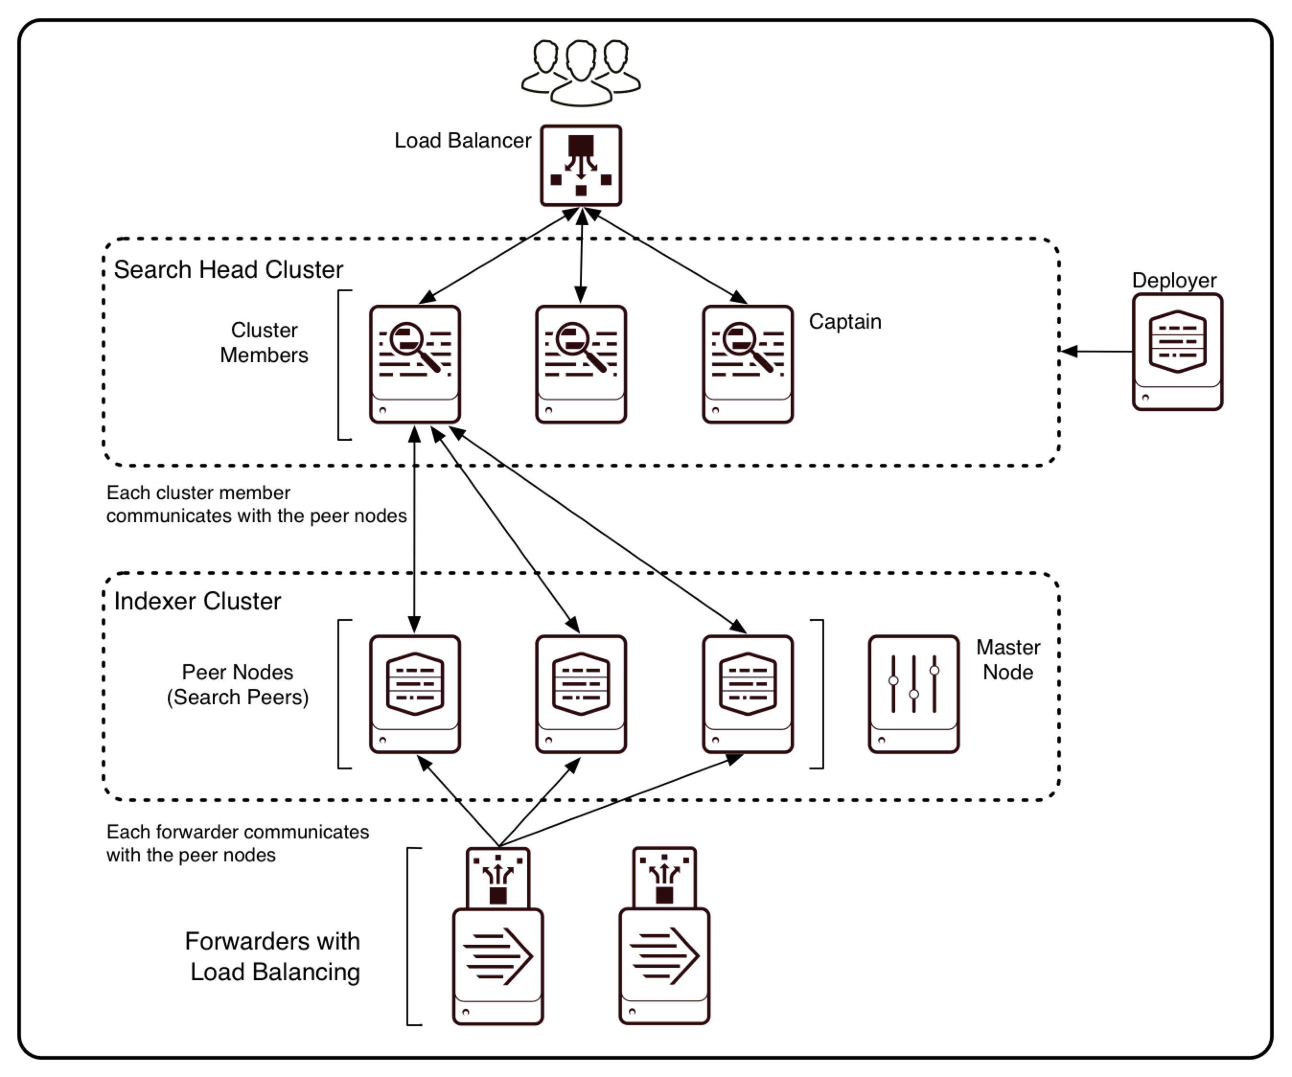
Imagine what you can build in 20 minutes!
SITE01
SITE02
SITE03

Slide 5
Docker Quick Overview
Began as an open-source implementation of the deployment engine which powers dot Cloud
A platform for managing Linux Containers
Rich set of API
Small footprint and fast
Very active user community

Slide 6
Linux Kernel Features used by Linux Containers
Namespaces
(mnt, pid, net, ipc, uts/hostname, user ids)
cgroups
(cpu, memory, disk, i/o - resource management)
AppArmor, SELinux
(security/access control)
seccomp
(computation isolation)
chroot
(file system isolation)

Slide 7
Why Docker?
Ship More Software Faster
Minimal overhead/resource usage
Speed, simplicity and application portability
Easy to run your whole production stack locally
Simply share your application with others
Faster delivery of your applications
Deploying and scaling more easily
Fully Automated, Easy To Deploy, Quickly Scale

Slide 8
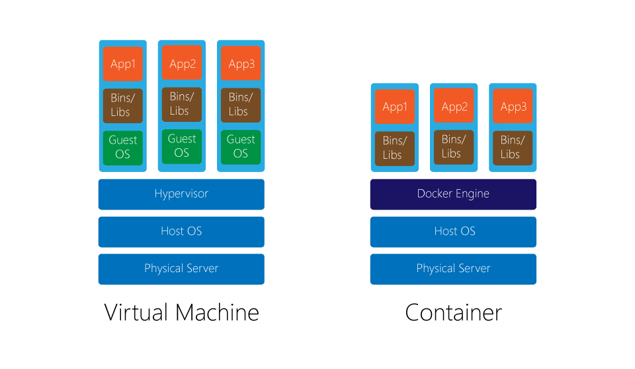
VM vs. Container
Virtual Machine
Container

Slide 9

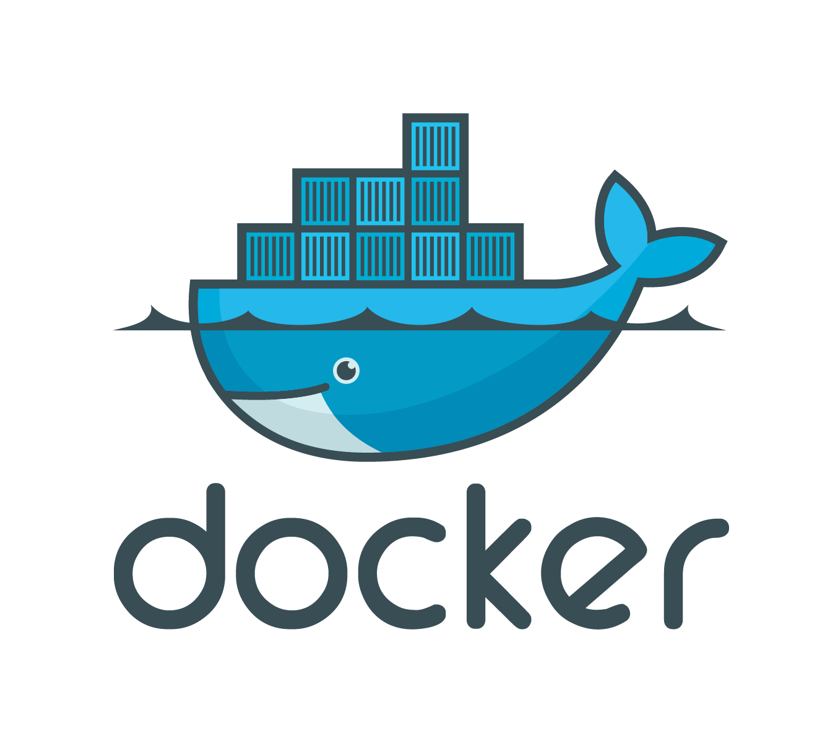
Where is Docker in this spectrum?
Splunk in Docker
Splunk in VM
Splunk Native

Slide 10
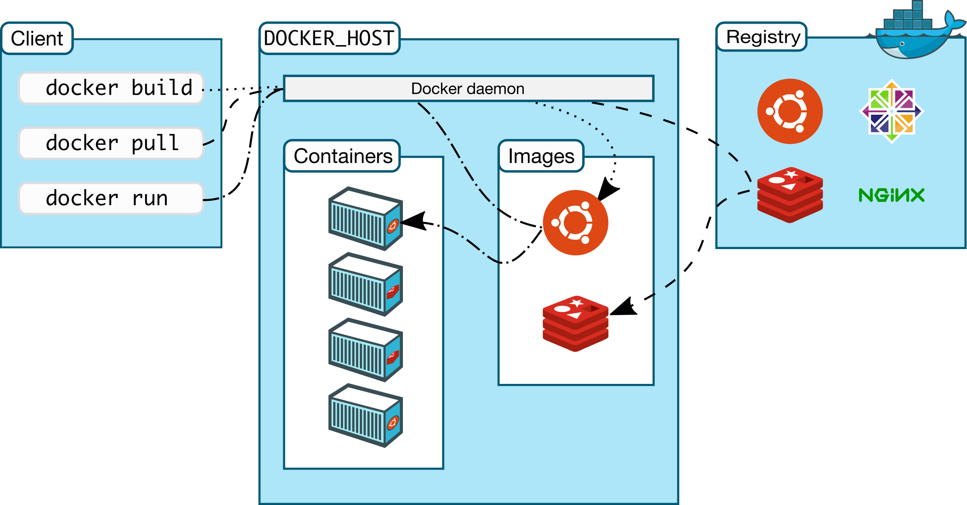
Docker Architecture
CLI
Docker daemon
Image Repo

Slide 11
Time to Provision Hosts:
Bare metal: DAYS
Cloud VM: MINUTES
Container: SECONDS

Slide 12
Docker Tools
Docker Compose: create and manage multi-container architectures
Kitematic: Simple application for managing Docker containers on Mac and Windows
Docker Swarm: orchestrating tool to provision and schedule containers
Docker Machine: provision hosts and install Docker on them
Virtual Box/Xhyve/Hyper-V: Virtualization software to run Docker host for Mac and Windows

Slide 13
Dockerfile?
Dockerfile is instructions to build Docker image
How to run commands
Add files or directories
Create environment variables
What process to run when launching container
Result from building Dockerfile is Docker image

Slide 14
Splunk n’ Box Possible Use Cases
Classroom or Search Parties
Fully replicate production environment in your lab
Learn Clustering without learning docker
Test upgrades, new features or configurations
Test integration with 3rd party (MySQL, Hadoop….etc)
Test apps in distributed environments
Splunk certification

Slide 15
Splunk n’ Box Features
Extensive error checking during startup & while building containers
Adaptive load control during cluster
Built-in dynamic hostnames and IPs allocation (DHCP like)
IP aliases binding. No need to translate Splunk ports or Nginx
Automatically create & configure large number of Splunk hosts very fast
Different levels of logging (show docker commands executed)
Fully configured multi & single site cluster builds (including CM and DEP)
Optimize for performance
Manual and Auto (standard configurations)
Modular design that can easily be converted to a higher-level language like Python
Custom login screen (helpful for lab & Search Parties scenario)
Eliminate the need to learn docker (but you should)
MacOS support

Slide 16
Configuring the script
ETH_OSX="lo0" #default interface to use with OSX
ETH_LINUX="eno1" #default interface to use with Linux
GREP_OSX="/usr/local/bin/ggrep"
GREP_LINUX="/bin/grep"
START_ALIAS_LINUX="192.168.1.100"; END_ALIAS_LINUX="192.168.1.254"
START_ALIAS_OSX="10.0.0.100"; END_ALIAS_OSX="10.0.0.254"
DNSSERVER="192.168.1.100”
LIC_FILES_DIR="licenses_files”; VOL_DIR="docker-volumes”
SPLUNK_IMAGE="mhassan/splunk”
RFACTOR="3”; SFACTOR="2”
STD_IDXC_COUNT="3" #default IDXC count
STD_SHC_COUNT="3" #default SHC count
DEP_SHC_COUNT="1”
DEFAULT_SITES_NAMES="STL LON HKG"

Slide 17
Host (container) naming rules
IDX : Indexer
SH : Search Head
DS : Deployment Server
LM : License Master
CM : Cluster Master
DEP : Search Head Cluster Deployer
HF : Heavy Forwarder
UF : Universal Forwarder
DMC : Distributed Management Console ( splunk 6.5 name changed to Monitoring Console)

Slide 18
MacOS Notes:
Default docker settings on MacOS are limited
Please change to take advantage of all available memory and CPU (under preferences).
Performance on MacOS is noticeably less than Linux
So be aware that you may not be able to bring up as many containers with similar hardware resources
Hosts will not be reachable from outside your laptop
Containers will bind to local loopback interface IP aliases on docker-host (i.e., your laptop). This is not the case in Linux runs.
Do not run any local splunkd instances on the docker-host
It will prevent Docker containers from starting due to network interface binding conflict.
Do not use older boot2docker stuff
If you Google OSX Docker install, you will see references to Oracle VirtualBox and boot2docker everywhere. Starting with Docker 1.12 Oracle VBOX is replaced with small new hypervisor called xhyve. Boot2docker is replaced with Moby (tiny Linux)

Slide 19
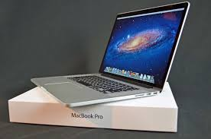

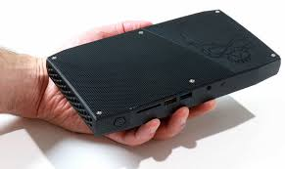
My LAB
STAND ALONE LAB (25 containers)
SEACH PARTY/CLASSROOM (80 containers)
$1200
MacOS Sierra 10.12.2
16G RAM
Intel core i7
$300
Netgear R800 router
SSID: splunk_n_box
$1000
32G RAM, 1TB SSD
Intel core i7
Ubuntu 16.0.4

Slide 20
Wi-Fi
SSID : Splunk-n-box
IP range 192.168.1.100-???

Slide 21
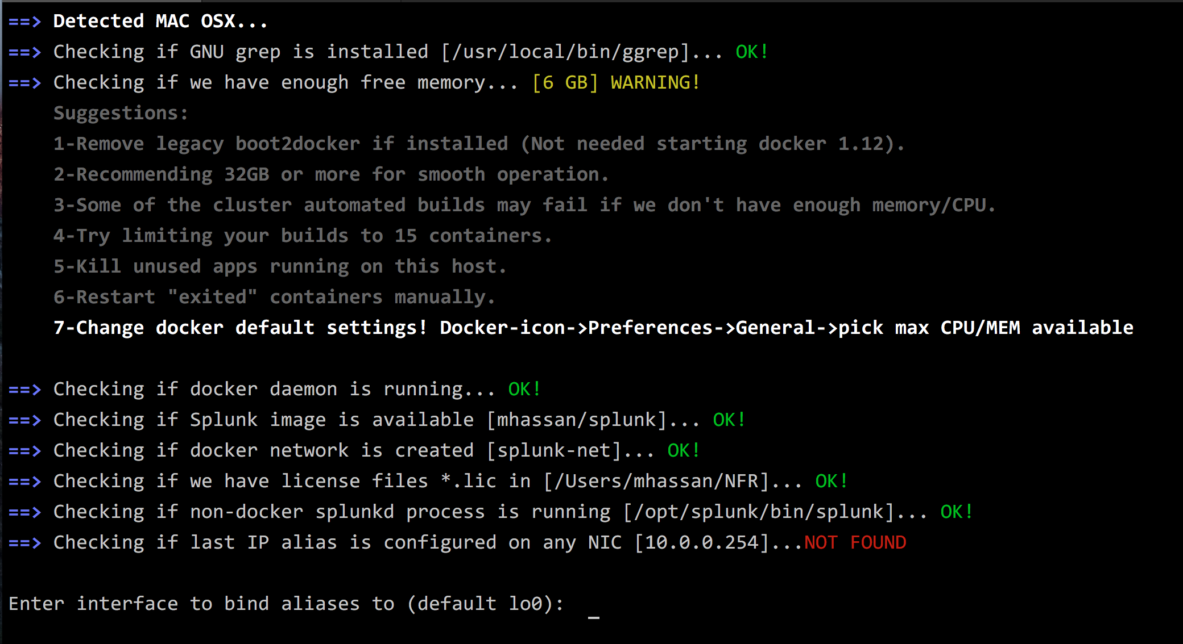
Starting Checks

Slide 22
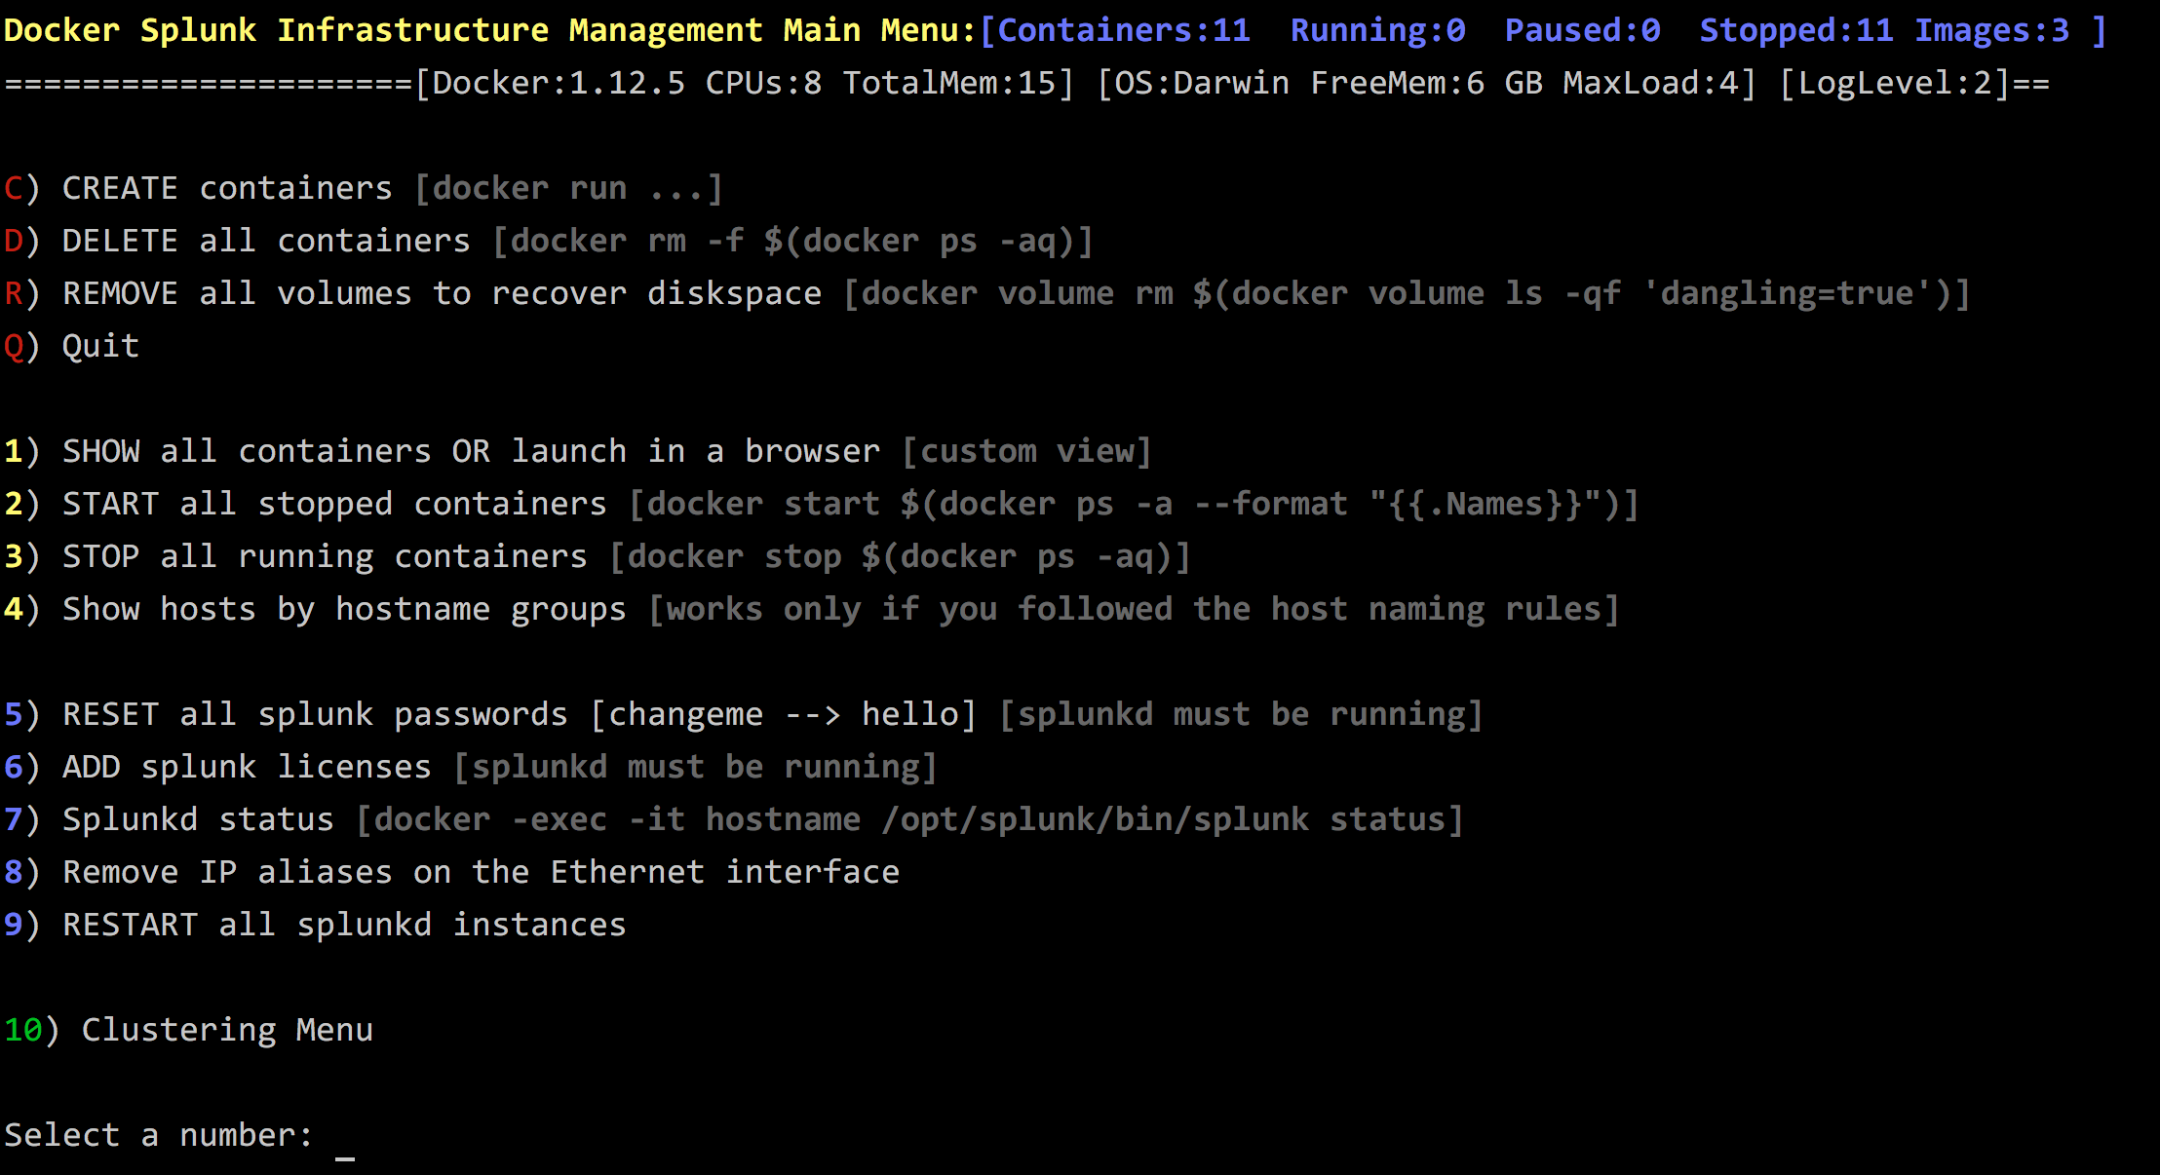
Main Menu

Slide 23
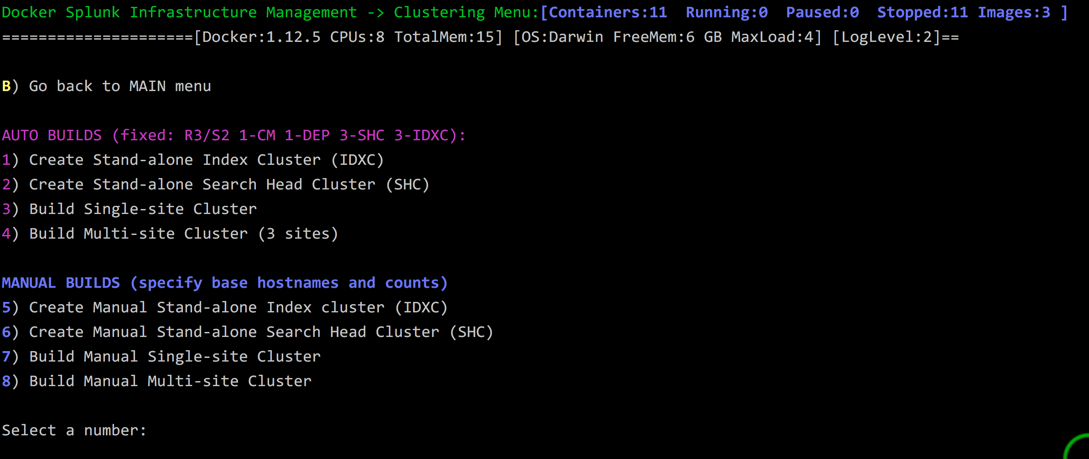
Clustering Menu

Slide 24
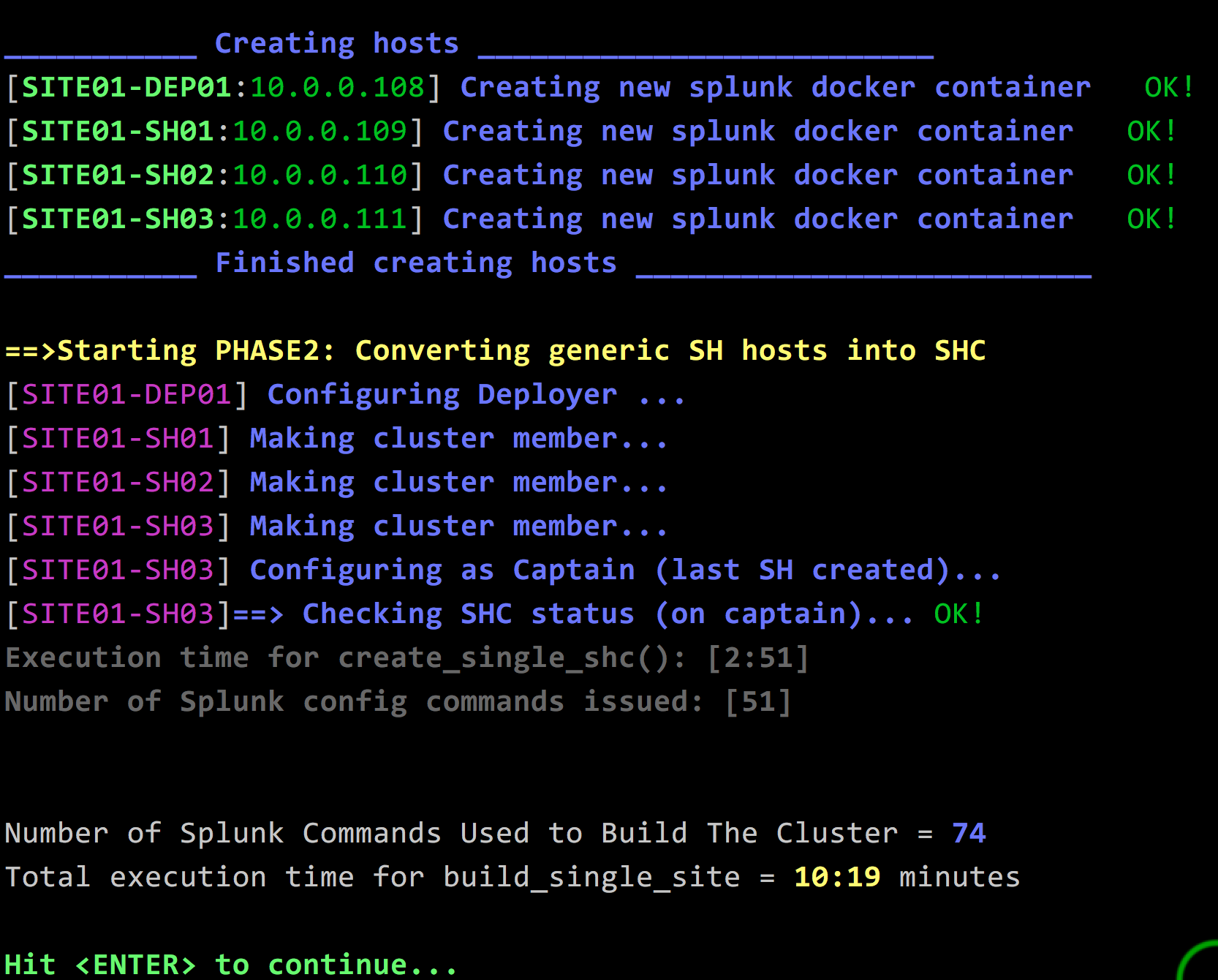
Finished run

Slide 25
Real Performance Numbers
Intel NUC Skull 32G/SSD/Intel core i7:
Basic Splunk container: (custom web.conf, pass changed , license file)
2 splunk commands 20 seconds
3-Site cluster: each site (3-IDX, 3-SH, 3-DEP), 1-CM, 1-LM
224 splunk commands 18:10 minutes
4-Site cluster: each site (10-IDX, 5-SH, 4-DEP), 1-CM, 1-LM
625 splunk commands 38:58 minutes

Slide 26
Q/A
Can you run different Splunk version?
Do I need valid Splunk licenses?
Where is vi, ifconfig, sshd? How do I login into the container (docker-ssh)?
Can I run this script in production?
Is this script supported by Splunk?
Does it run on other Linux distribution beside Ubuntu or OSX?
Does it run on Windows?
Is the script using docker swarm?
Why there is a hypervisor used with MacOS/Windows?
Can I run this script inside a VM?

Slide 27
Final Thoughts
No need to learn docker
Quick and easy way to learn clusters
10-15 script installation time
Learn docker in 10 minutes video: https://www.youtube.com/watch?v=YFl2mCHdv24
Full & detailed Splunk n’ Box video (google splunk n box): https://www.youtube.com/watch?v=k1WmnlWa4lo&feature=youtu.be

Slide 28
DEMO

